Slide 1
RURAL DEVELOPMENT

Slide 2
Rural development: Social, Economic and Educational Development of village areas

Slide 3
Rural Development includes the following:
HUMAN RESOURCE DEVELOPMENT:
Literacy, Education, Skill Development and Health Facilities
LAND REFORMS TO MAKE REAL TILLER OWNER OF LAND
DEVELOPMENT OF LOCAL RESOURCES
DEVELOPMENT OF INFRASTRUCTURAL FACILITIES
POVERTY ALLEVIATION AND EMPLOYMENT GENERATION PROGRAMMES

Slide 4
IMPORTANCE OF RURAL DEVELOPMENT
More than two – third of the population depend on agriculture. They live in villages.
Most of the poor people live in villages.
Agricultural growth rate has decreased to 3% per annum.
Cottage and village industries have declined.
So, to improve the welfare of people steps should be taken for the development of villages.

Slide 5
RURAL CREDIT

Slide 6
RURAL CREDIT
The word credit literally means faith.
Credit is an arrangement by which the lender gives money or goods to a borrower in return for a promise of repayment in future.

Slide 7
IMPORTANCE OF RURAL CREDIT
Credit is needed to buy seeds, fertilisers, implements etc. It is also needed to meet other expenditure till the crops are ready.
Credit is needed to buy additional land and to make wells and tube wells.
Credit helps to start small scale industrial units in village areas.
During crop failure, credit will help farmers to survive and to continue cultivation.
Credit helps a farmer to adopt new technology.
Credit is needed to meet family expenditure during marriage, death or religious functions.

Slide 9
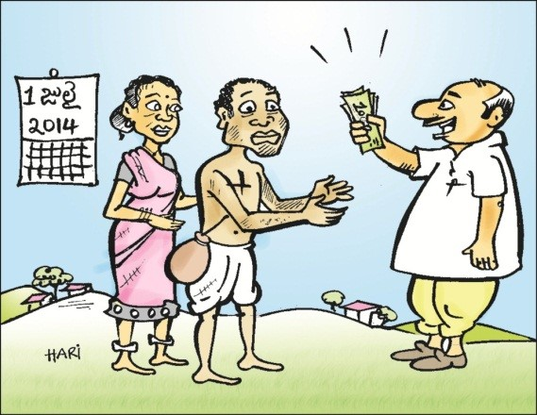
INFORMAL SOURCES (NON INSTITUTIONAL SOURCES) OF CREDIT

Slide 10
Money Lenders, friends, relatives, traders and land lords are the informal sources of credit.
They are not controlled or supervised by any government agency.
They charge very high rate of interest.
They exploit the borrower.
Some of them cheat the borrowers.
The borrower will fall in to debt trap.
It is easy to get loans from them.

Slide 12
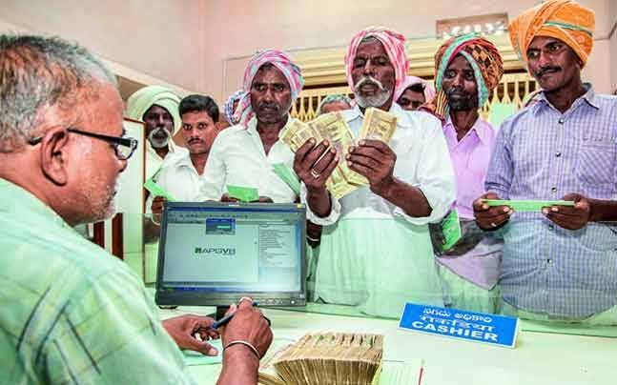
FORMAL SOURCES
(INSTITUTIONAL SOURCES) OF CREDIT
Banks, Co-operative Societies, Regional Rural Banks and NABARD are formal sources.
.

Slide 13
COMMERCIAL BANKS
The RBI has instructed Banks to make short term, medium term and long term loans available to farmers
Kissan Credit Cards are given to farmers. They can get short term loans using these cards.
It is difficult for poor farmers to get loans from Banks.
Branches of Banks are not there in many villages.
The Banks demand collateral security. The poor farmers do not have anything to offer as collateral security.
The Banks do not consider poor farmers credit worthy.

Slide 14
Co-operative Societies
Co-operative societies give loans to the farmers at reasonable rate of interest.
They do not demand any collateral security.
They supply HYV seeds and fertilisers to farmers.
The educate farmers about new methods of farming.

Slide 15
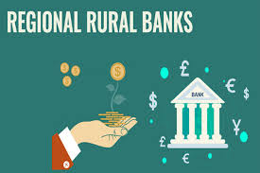
Regional Rural Banks
They are set up jointly by the Central and the State Governments to meet the credit needs of rural people.
They provide short term, medium term and long term loans to farmers at very low interest rates.
They are sett up in village areas.

Slide 16
NATIONAL BANK FOR AGRICULTURAL AND RURAL DEVELOPMENT (NABARD)
NABARD was set up in 1982.
The institutions that provide credit to village people get support and help from NABARD.
It gives funds to institutions that provide rural credit
It give training to people involved in credit delivery.
It evaluates the projects financed by it.

Slide 17
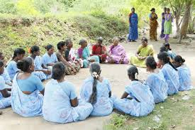
SELF HELP GROUPS
It is a village based organisation consisting of 10 to 20 women.
Each member contributes a small amount.
Members can get loans from the group.
The SHG can get loans from Banks.
SHG helps women to find Self Employment.

Slide 18
Achievements of Rural Credit in India.
Farmers could adopt new technology
Famines could be avoided
Small scale units came up
Employment Increased and Poverty reduced.

Slide 19
Failures of Rural Credit System
Failed to develop the habit of saving and depositmobilisation
Recovery of loans is not effective

Slide 20
Role of Micro Credit
Micro credit is provided by Self Help Groups.
Micro credit facility saves villagers from the exploitation of money lenders.
It helps villagers to start micro production units and earn additional income.
SHG s encourage saving habits among the village people .
They also contribute towards women empowerment.

Slide 21
It is difficult for village people to get credit from formal sources
Banks demand collateral security. Most of the villagers do not have any collateral security.
Banks do not consider poor people credit worthy. They are not interested to give loans to poor people.
Bank branches are not found in many villages.
Banks demand several documents. Poor people will not be able to arrange these documents.

Slide 22
AGRICULTURAL MARKETING

Slide 24
Obstacles in the path of Agricultural Marketing
(Problems faced by farmers while marketing their goods)
Traders cheat farmers by wrong weighing and manipulation of accounts.
Farmers generally do not know the prices in the markets. So, traders pay them low prices.
Farmers do not have proper storage facilities.
Most of the villages do not have good roads.
There are many middle men between the farmer and the consumer. So, farmer gets low prices.

Slide 25
Steps taken by the Government to promote Agricultural Marketing
1. Regulated Markets:
The Government has established Regulated Markets in different parts of the country.
The sale and purchase of goods in these markets are controlled by a market committee consisting of representatives of Government, farmers and traders.

Slide 26
2. Development of Infrastructural facilities: The Government has taken steps to construct roads, ware houses, cold storages and processing units to help farmers to market their goods.
3. Co- operative Agricultural Marketing Societies: The co-operative societies of farmers may collect the products and profitably market them in towns and cities.
4. Farmers Market: In some states like Tamil Nadu, the Government established Farmers Market. The farmers can bring their products directly to these markets and sell to consumers. Middle men can be avoided.

Slide 28
FARMERS’ MARKET
APNI MANDI – PUNJAB, HARYANA AND RAJASTHAN
HADASPAR MANDI – PUNE
RYTHU BAZAR – ANDHRAPRADESH AND TELANGANA
UZHAVAR SANDHAI – TAMIL NADU

Slide 29
4. Storage Facilities: The Government has set up a number of pest free and weather proof storage facilities to farmers to store their products.
5. Minimum Support Price: The Government announces MSP for some agricultural crops well before the sowing season. At the time of harvesting, if the market price is lower than the MSP, the Government will buy those crops from the farmer at the MSP.
6. Some Multi National Enterprises enter in to agreement with farmers. They encourage farmers to cultivate certain crops. They provide them seeds, fertilisers and money in advance. Later, they buy the products and market them.

Slide 30
AGRICULTURAL DIVERSIFICATION

Slide 31
AGRICULTURAL DIVERSIFICATION
Production of a number of crops in the same farm along with various non-farming activities is called Agricultural Diversification.
Sericulture, Dairy farming and Fish farming are some of the non-farming activities.
Farming becomes profitable and less risky.

Slide 33
MIXED FARMING

Slide 34
ANIMAL HUSBANDRY

Slide 35
ANIMAL HUSBANDRY
Animal Husbandry is the breeding and caring of animals such as cattle, goats and fowl.
It provides stable income to the farmer.
Animals help in transportation and agricultural work.
It provides food stability and the fuel needed for the villagers.
Large number farmers earn their livelihood from animal husbandry.
Animal waste can be used as manure.

Slide 37
FORESTRY

Slide 38
FORESTRY
Scientific utilisation of forests and forest products is called Forestry.
It can provide additional inxcome to the farmers who live in villages located close to forests.

Slide 40
SERICULTURE
Rearing of silkworms and the production of silk and silk products is called Sericulture.
It provides additional income to the farmer.
It reduces poverty in villages.
It reduces unemployment

Slide 42
HORTICULTURE
It is the art of cultivating fruits, vegetables flowers, medicinal plants and spices.
It contributes one – third of the total value of agricultural products.
It contributes 6% of the GDP of India.
India is the second largest producer of fruits in the World.
It enables farmers to earn high income.

Slide 44
FLORTICULTURE

Slide 45
FLORTICULTURE
It is a branch of Horticulture.
It is the scientific cultivation of flowers.

Slide 46
The role of Non-Farm Activities in promoting Rural Development
Non- farming activities reduce population pressure on land. Surplus labour in agriculture can be used in such activities.
They help the farmer to sell value added products and earn higher income. Thus they help in reducing poverty.
Farmers can get themselves engaged in non-farm activities during off season. Thus, they solve seasonal unemployment.
Even a loss in farming due to crop failure will not affect the farmer much if he has some non-farm activities also.

Slide 47
IMPORTANCE OF AGRICULTURAL DIVERSIFICATION FOR SUSTAINABLE DEVLEOPMENT
Agriculture in India depends on monsoon rains. So, it is risky. Diversification will help farmer to earn income from non-farm activities.
During rabi season, agricultural activities are less. There will be unemployment. It can be reduced by developing non-farming activities.
Diversification will help to reduce disguised unemployment.
Diversification with different farming and non farming activities helps the farmer to earn higher income. This improves their standard of living.

Slide 49
ORGANIC FARMING
It is a system of farming that uses organic inputs. Chemical Fertilisers, pesticides and insecticides are not used. Bio manure and biological methods of pest control are used.

Slide 50
IMPORTANCE OF ORGANIC FARMING FOR SUSTAINABLE DEVELOPMENT
It is environment friendly. Chemicals are not used. So, it does not damage the environment.
It protects soil health. It sustains the quality of soils.
It produces nutritious and tasty food. The crops are free from dangerous chemicals.
It does not use Non-Renewable resources. Thus, it promotes sustainable development.
It is less expensive. It uses locally available resources. Farming becomes profitable.
Organic crops have good demand in other countries. We can get foreign exchange.
It is labour intensive farming. So, many people get work.

Slide 51
LIMITATIONS OF ORGANIC FARMING
Lack of awareness among the farmers. Many are unwilling to take up organic farming.
Infrastructural facilities are not sufficient and marketing facilities are limited.
Yield from organic farming is less. This will discourage farmers from adopting it.
Organic products have more blemishes and shorter shell life.
We do not have adequate demand for organic products as they are costlier.
It requires inputs like organic manure. Bio-fertilisers and pesticides. Farmers find it difficult to get.

Slide 52
PROBLEMS FACED BY FISHING COMMUNITY
Most of the fishing families are very poor. Their per capita income is very low.
Many of them are illiterates and ignorants.
They are not willing to shift to other jobs.
Most of them are in debt trap.
Adverse weather conditions affect them badly.

Slide 54
ROLE OF INFORMATION TECHNOLOGY IN SUSTAINABLE DEVELOPMENT AND FOOD SECURITY
Information Technology can help to achieve sustainable development and food security in the modern World.
The Government can find out areas of food insecurity and vulnerability by using Information Technology.
IT can be used to provide information to farmers about new crops, technology and market conditions.
IT can create employment opportunities in village areas.

